Slide 1
Data Visualization of Bird Strikes between 2000 – 2011

Slide 2
Objective:
Make a dashboard to visualize of bird Strikes by Airplanes in the U.S. between 2000-2011
Benefits:
Find different consequences of strikes.

Slide 3
Data Sharing Agreement :
Sample file name (Bird Strikes Final)
Number of rows - 26
Number of Columns - 25559

Slide 4
Architecture
Start
Collect Data
Data Validation
Data Transformation
End
Find result
Export data in tableau

Slide 5
Introduction
Bird strike risk increases because of bird migration during the months of March through April, and August through November
Bird and other wildlife strikes to aircraft annually cause over 600 million in damage to U.S. civil and military aviation, putting the lives of aircraft crew members and their passengers at risk.
Since 1988, over 195 people have been killed worldwide as a result of wildlife strikes.

Slide 6
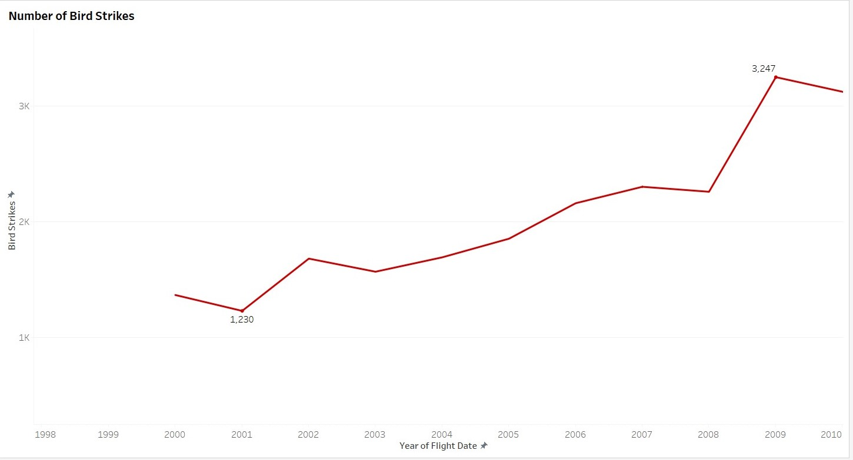
Number of Bird Strikes

Slide 7
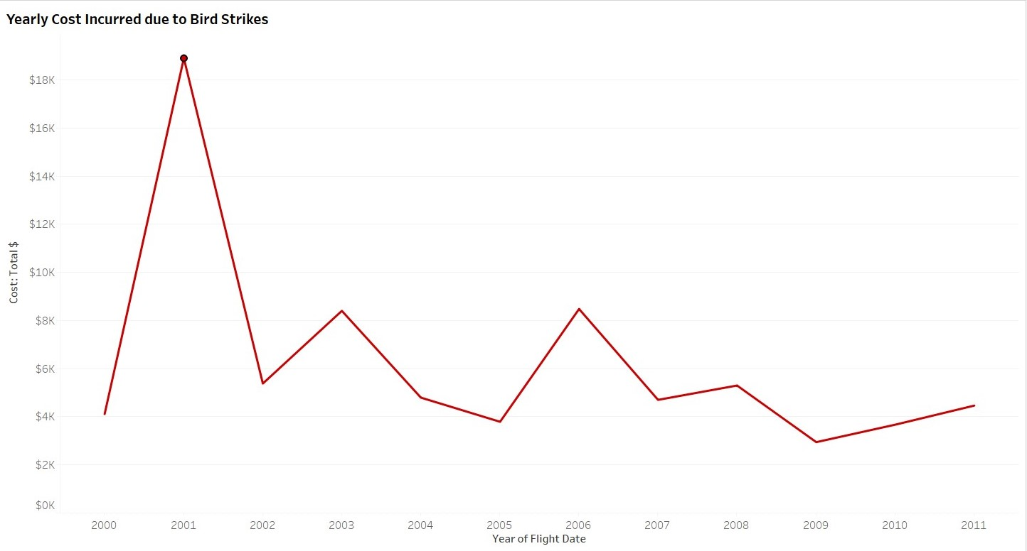
Yearly Cost Incurred due to Bird Strikes

Slide 8
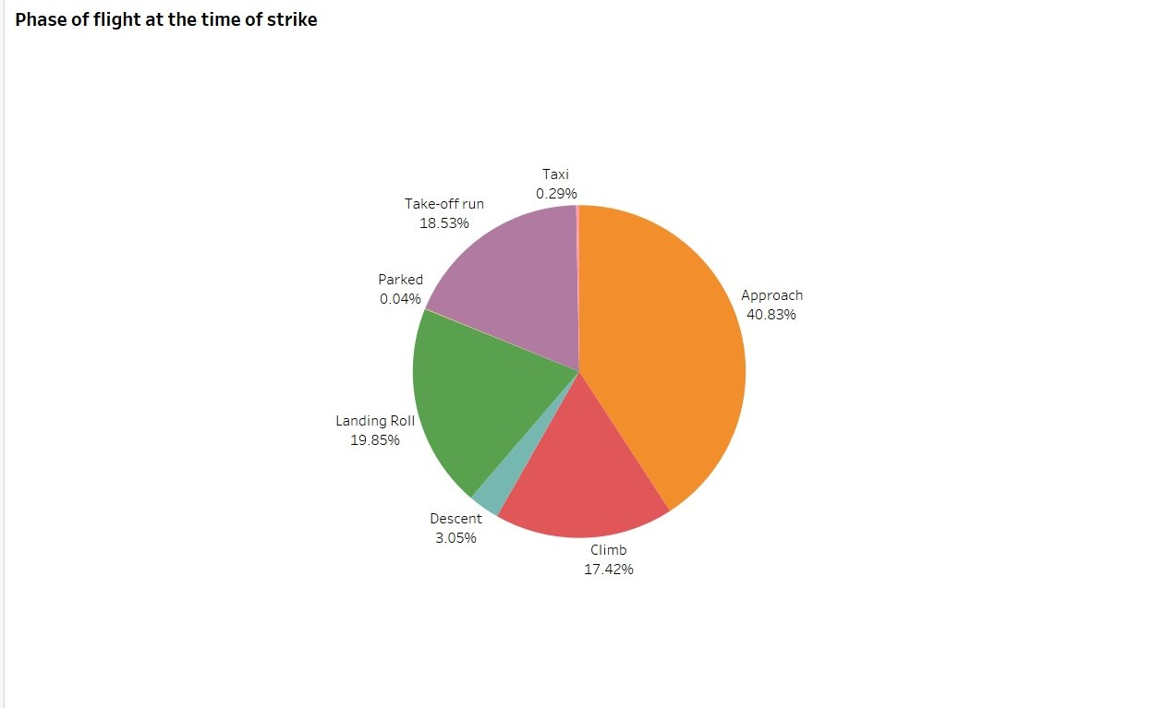
Phase of flight at the time of strike

Slide 9
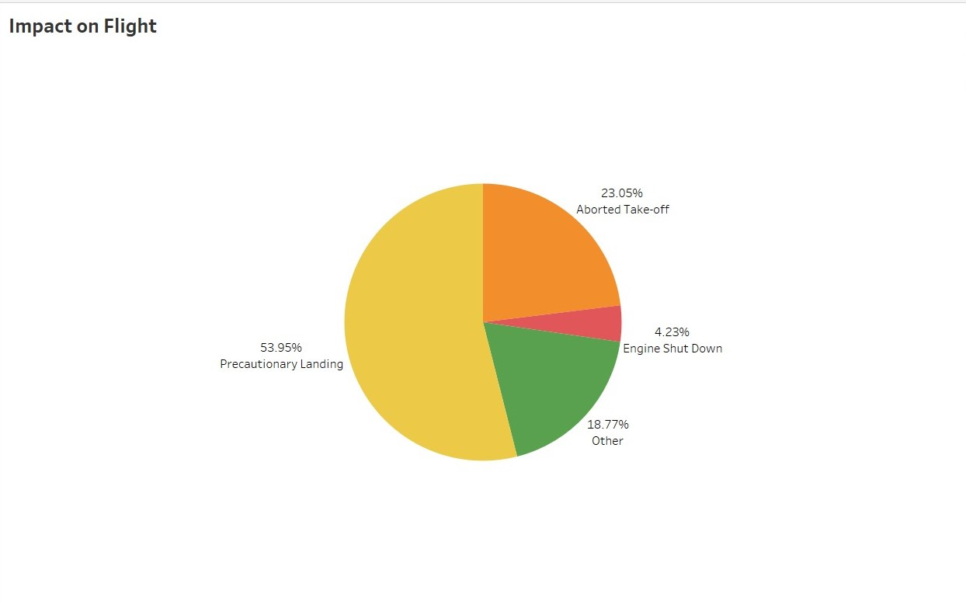
Impact on Flight

Slide 10
Q & A:
Q1) What’s the source of data?
The data is provided by Ineuron in csv format.
Q 2) What was the type
The data was the combination of numerical and Categorical values.
Q 3) What techniques were you using for data pre-processing?
Removing unwanted attributes
Removing outliers
Cleaning data and imputing if null values are present.
Converting categorical data into numeric values.

Slide 11
Q 4) What are the different stages of deployment?
We deploy on Tableau Public server.

